Slide 1
Understanding Models
It Matters…somewhat

Slide 2
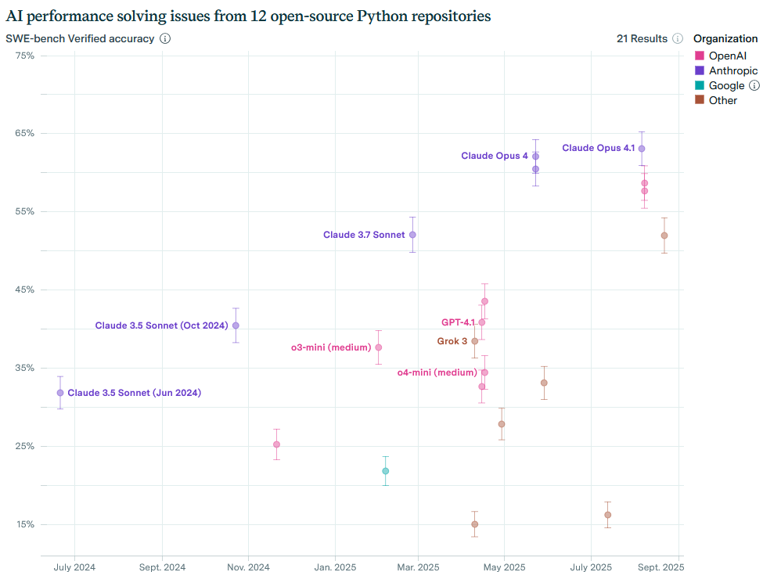
https://epoch.ai/benchmarks#benchmarks

Slide 3
Better models = $$$$

Slide 4
The Basic Large Language Models
Trained to excel at predictive text generation
Consume massive amounts of unlabeled internet data and “learn” the underlying rules of language/code/whatever
Can be “prompted” to do the right thing:
Q: What does the scheme function call/cc do?
A: ??????
No modern system directly uses this approach by itself – but all systems fundamentally rely on this internally
By providing specialized datasets, we can make specialized built-to-purpose AIs

Slide 5
Basic LLMs are based on the raw data of the internet/newspapers/etc.
From a huge amount of input data they create an internal representation or “model” without direct human intervention
But this approach is limited in that we have already used the whole internet to train AIs. To progress more we would need:
Large amounts of untapped good quality data (and the processing power to harness it, but that is easier than the data itself)
New algorithms that let us learn more from the data we already have
Many many folks are working on the above and perhaps new breakthroughs will arise. But most “new features” you see with Ais are based on incremental improvements in the model + tricky ways of leveraging the existing intelligence

Slide 6
Instruction tuned LLMs
Given curated training data designed to provide examples of ideal responses to common tasks OR maybe highly ranked results of previous llms
Allows the AI to follow instructions e.g. do this task, then do this task – though it’s worth noting that this is nothing like a computer program
Also allows specific task templates (e.g. summarize this) to be built in
(I think this is where Ais get their “character” from)
Examples ChatGPT 4, Claude

Slide 7
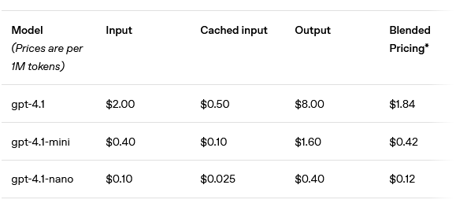
Mini models are cheaper – maybe not faster
AI cost is usually in terms of input “tokens” and output “tokens” (think words). The more the AI must read in, the more its is expected to write, the more you pay.
Queries hand entered by humans and read by humans tend to be pretty cheap (hence why they are given away). If you want an AI to read megabytes of say server logs it might be worth it to go with cheaper models.

Slide 8
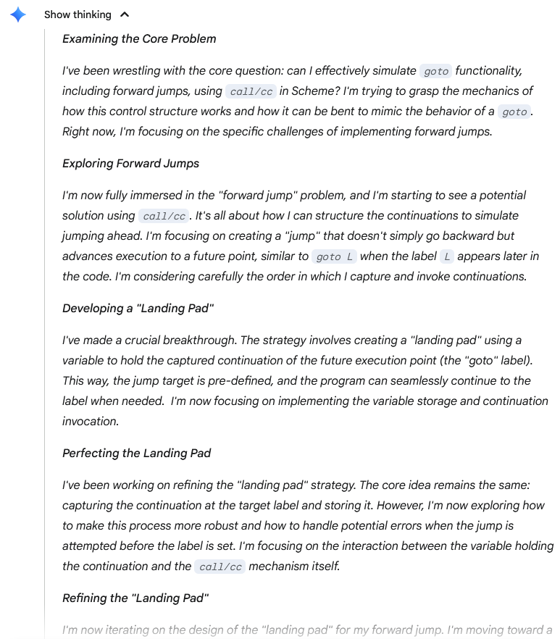
Reasoning
Using AI to plan and also using AI to evaluate the results
https://gemini.google.com
Reasoning 2.5 Pro model

Slide 9
Reasoning
Generally higher quality results
Much slower/more expensive
Still fundamentally the same underlying “intelligence” just iterating on the problem in a structured way
A lot of specialized AI “tools” adopt this approach as well, with human developers specializing a series of prompts to guide the AI in a useful direction

Slide 10
Agentic models
Allows the AI to “do things in the world” and see the results, then use those results to do further steps
Actions in the world can be things like “do a websearch and read the results” or “run tool xyz on the command line and see what it prints”
The results provide inputs and let the AI guide itself
Exactly what actions are possible depend on the particular system
Having the AI “doing things in the world” can also be a problem

Slide 11
Agentic AI: Deep Research Models
Kinda like reasoning models + websearch
The AI considers what data it might need to answer the prompt, then goes and gets data externally, then analyzes those results, then goes and gets more data
Very slow and therefore expensive
Good in that the AI is basing its reasoning on sources
Again, though, the same basic “intelligence” is a work here – if it finds the wrong source or can’t correctly understand the source, it can still get itself into trouble

Slide 12
Agentic models: Programming Models
Allows Ais to run tests and look at outputs and therefor self-correct as they do programming tasks
Much slower than simply generating code because they must generate code, look at failures, generate fixes, run again etc. Can be very slow for big tasks on large codebases
Depend on things like good unit tests and helpful error messages to act smart
Can get themselves off track
We will explore tools that do this realtime in this course
There are companies that will let you run these systems autonomously to automatically build features etc.

Slide 13
Which Programming Model Should I Use?
I did a little experiment. Earlier this week I ran across a small bug in a personal project. Like most bugs, it was initially not obvious what the issue was. Probably took ~10 minutes of exploration to diagnose and understand the issue.
I reverted my code back to the pre-bug state and gave a prompt including the files that were the starting point of my investigation the behavior I saw, and the instructions to diagnose the bug and ask me any questions that were necessary.
None asked me any questions.
I gave the same prompt 3 times, each in a new chat with different models enabled: Claude 4 sonnet thinking, Chat GPT 5 thinking, and gemini 2.5 thinking

Slide 14
Results
All 3 models incorrectly diagnosed the bug, all 3 of them came back with essentially the same explanation. In all cases, the explanation did not really track the actual description of the symptoms and misunderstood how the system as a whole operated. They overfocused on the code I had given them rather than following my instructions to look at files they needed to.
In all cases, if I had relied on their explanation I would have wasted significant time chasing ghosts

Slide 15
What do I take away from this?
I am sure in some cases these models are better or worse than each other
But in all cases they share similar characteristics:
OK at doing grunt work when given explicit instructions about what to do
Very reliant on particulars of prompting, files in context, etc.
Extremely overconfident and unreliable

Slide 16
What to do?
I think if you’re excited about AI (or your boss is paying) there’s probably some benefit in using one of the more advanced paid models – especially if you can get it to charge you a la carte
Claude currently has a lot of positive buzz – seems like the most “standard” pick
I don’t think there’s evidence to suggest that there is a “revolutionary” model currently out there that acts in a much smarter way the others
Things could change, but also bear in mind that there is a lot of incentives for actors in the system to overestimate how exciting things are

